Slide 1


Slide 2

Group Members :-
MR. SURAJ LAXMAN KADAM
Ms Rashika Anantrao Shrirame
Arukala Kavya
Mr . Ronith Sai Gadiraju
MR.DHARMA TEJA COOLI
Mr Soorya prasath J
Mr. Kale Tejas Ghansham

Slide 3


Concept use in project ->
Introduction
Machine Learning
Vectorization
Cosine Similarity
Conclusion & Result

Slide 4
Introduction
A Recommended System is a type of information Filtering System which attempts to predict the Preferences of a user, and make a top 5 suggestion based on this preferences.

Slide 5
Methodology :-
Content Based :-
The Recommendation System recommends other movie which are similar to that of selected movie.
2) Collaborative Filtering :-
The recommendation System recommends movie which are rated highly by the similar users.

Slide 6
EDA

Slide 7
Dataset Usage :-
We have used IMDB Movie Dataset.
This Dataset consist of :-
5000 Movie With there Rating, Year Of Released, Certificate, Gross Income, Votes, Description, Genres, Directors, Stars.
Since We have Developed a Prototype Of Content Based Recommendation System. We Have also Scraped the Content Based Data from IMDB Website for movies.

Slide 8
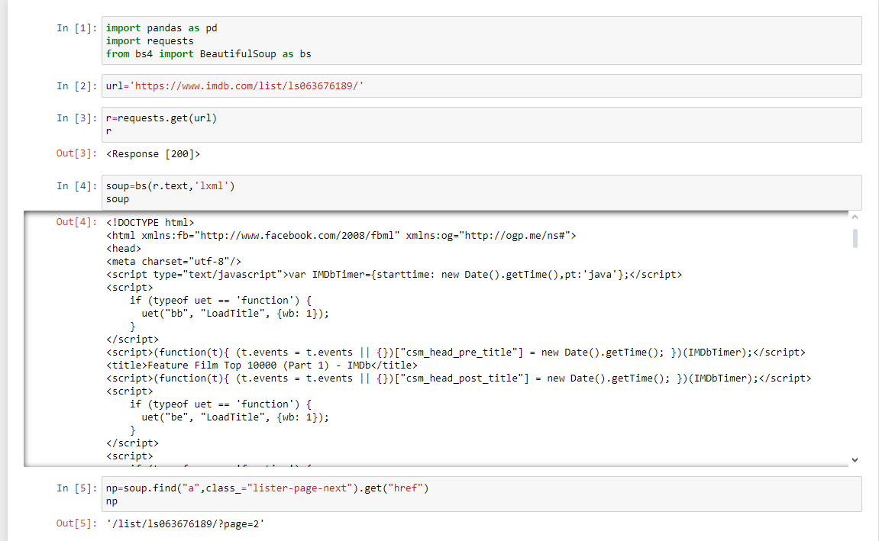
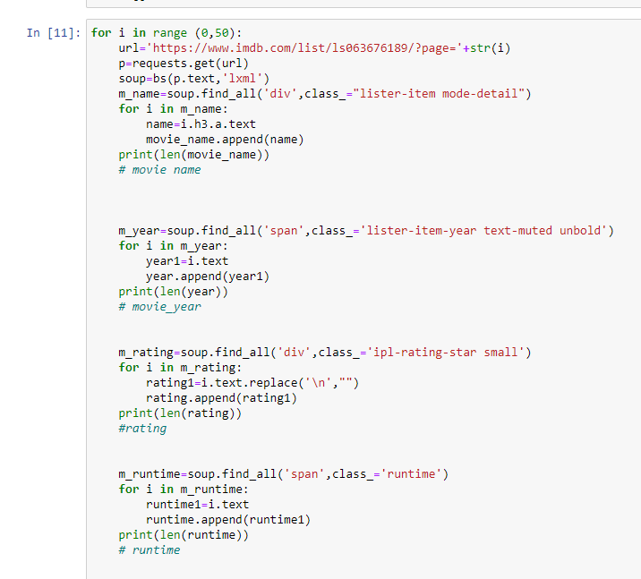
Scraping Of Data From imdb :-

Slide 9
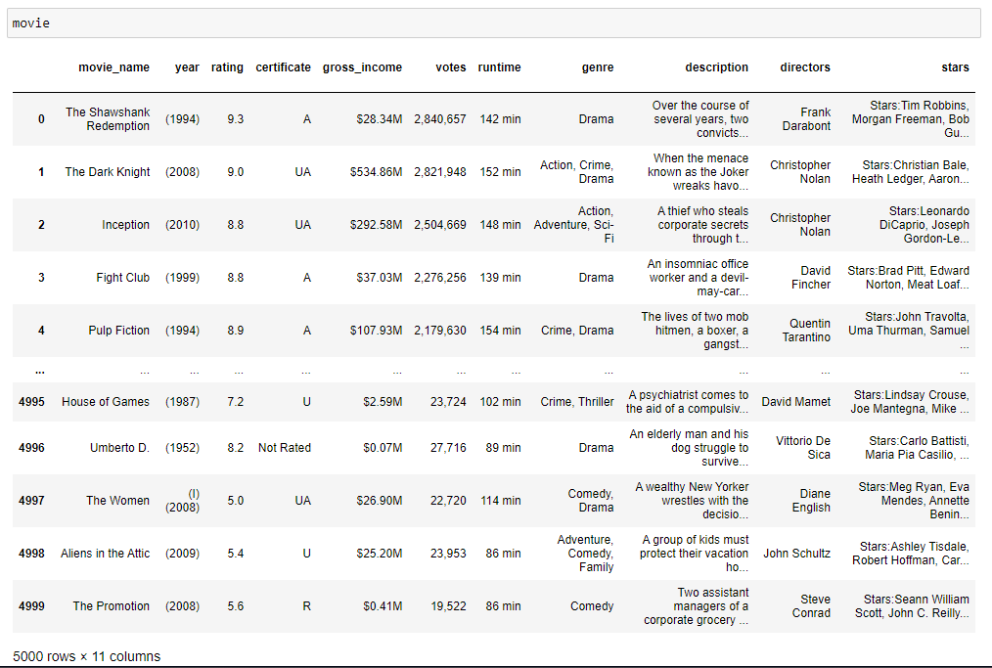
Steps For Program:- 1. Import Dataset 2. Edit Using Python - Clear Unwanted Data - Removing Duplicates - Replace Null Values in Dataset.
Final Collected Dataset :-

Slide 10
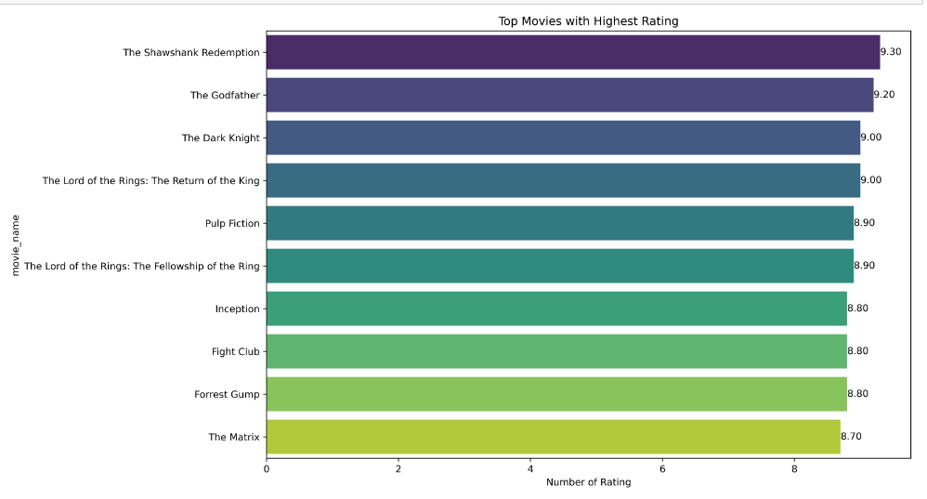
Top 10 Movie According to Rating
From the above bar graph we come to know that "The Shawshank Redemption" is highly rated movie among the 5000 movie.

Slide 11
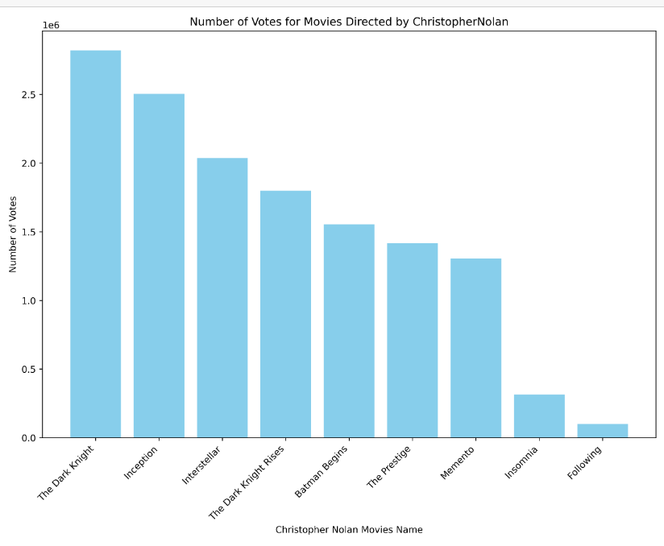
Movies of perticular director as per votes
From the above bar graph we come to know that the director Christopher Nolan movie The Dark knight having maximum voted among all movie directed by him among the 5000 movie.

Slide 12
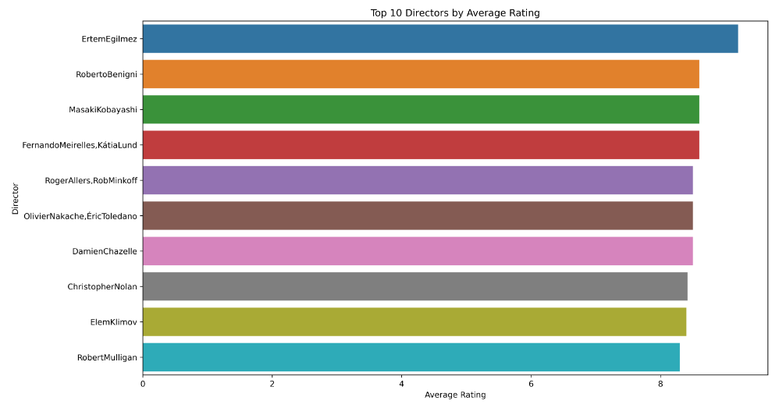
Top 10 directors by average rating
From the above bar graph we come to know that Ertem Egilmez having highest rating of the directors among the 5000 movie..

Slide 13
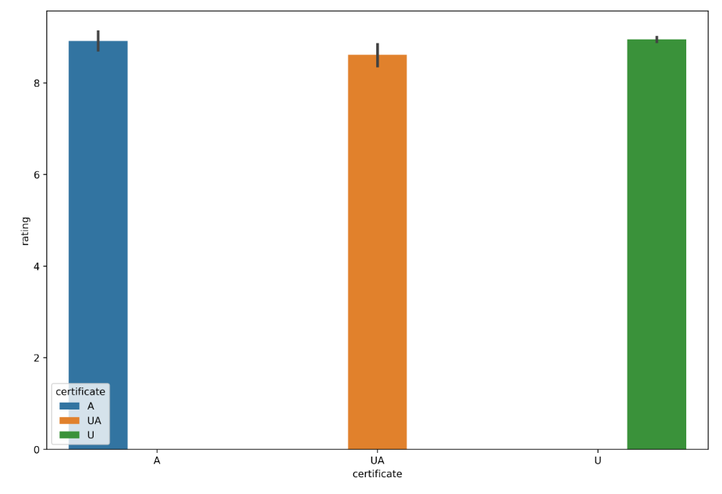
Certificate by rating
From the above bar graph we come to know that in dataset the A certificate movie is maximum.

Slide 14
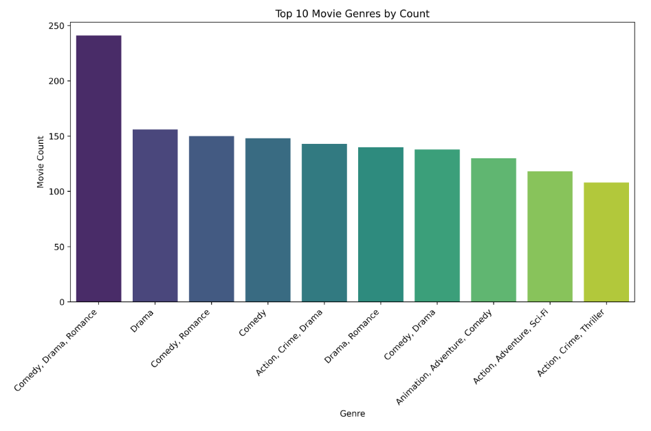
Top 10 Genres
From the above bar graph we come to know that Count around 240 is maximum for genres Comedy, Drama, Romance

Slide 15
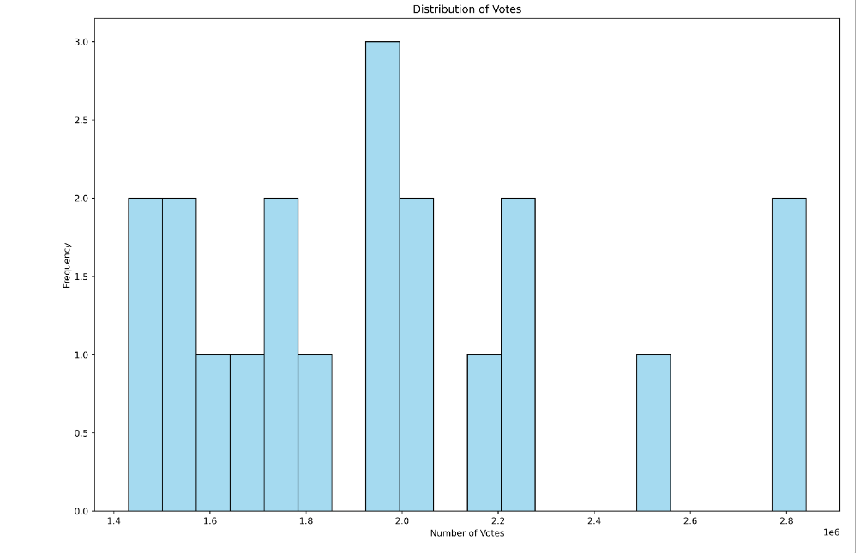
Distribution Of votes
From the above bar graph we come to know that Distribution of votes for movie in dataset
And the top movie having greater than
2 crores votes.

Slide 16
Text
Vectorization

Slide 17
Text vectorization
Firstly import the nltk Library. From this import following :-
CountVectorizer :- It feature extraction method in the scikit-learn library (sklearn) that converts a collection of text documents to a matrix of token counts.
PorterStemmer :-The PorterStemmer is a stemming algorithm designed to remove the suffixes (prefixes in some cases) of words to obtain their root form, or stem.

Slide 18
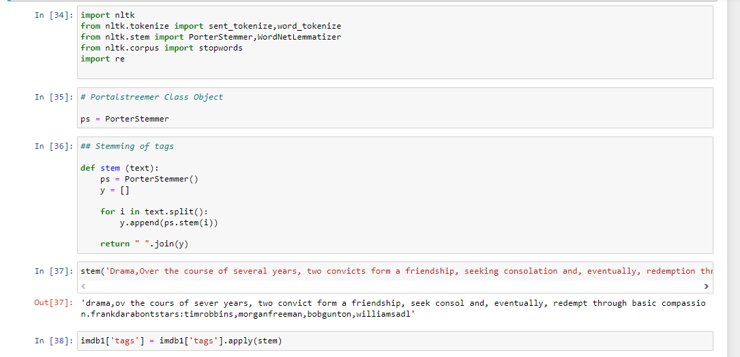
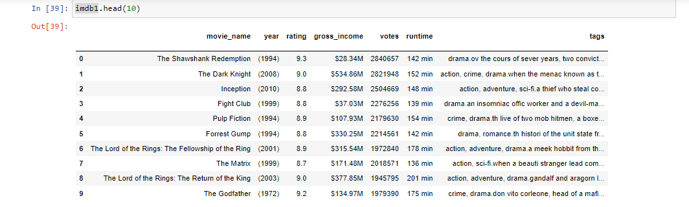
Import Lib. Performing
Portal Stemmer Operation

Slide 19
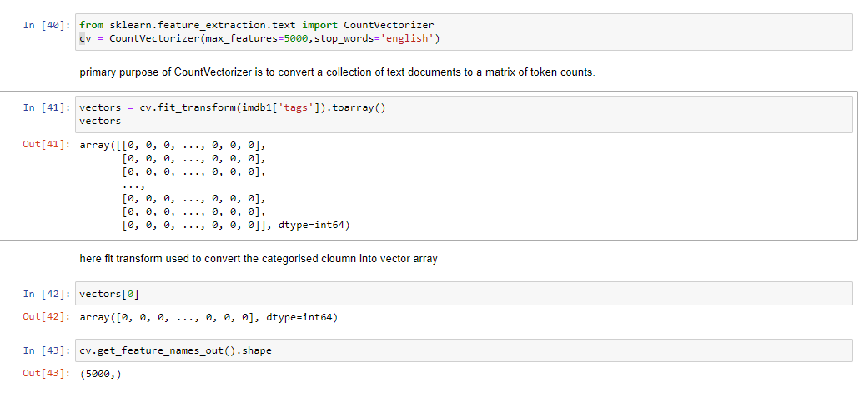
Vectorization
Text vectorization is a crucial step in text mining and natural language processing (NLP) that involves converting textual data into numerical representations.
The goal is to transform unstructured text data into a structured format that can be used by machine learning algorithms for analysis and modeling.

Slide 20
Cosine similarity
Cosine similarity is a metric used to measure how similar two vectors are, particularly in the context of text mining and natural language processing.
It calculates the cosine of the angle between two non-zero vectors in an inner product space, which gives a measure of similarity between the vectors.
In the context of text mining, these vectors often represent the frequency or presence of terms (words) in documents.
Similarity is invers of distance range 0 to 1
If similarity is 1 then similarity vector is Similar and similarity is high &
Similarity is 0 then vector is not similar and less similarity.

Slide 21
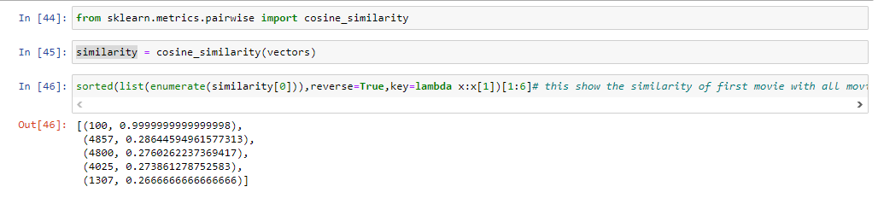
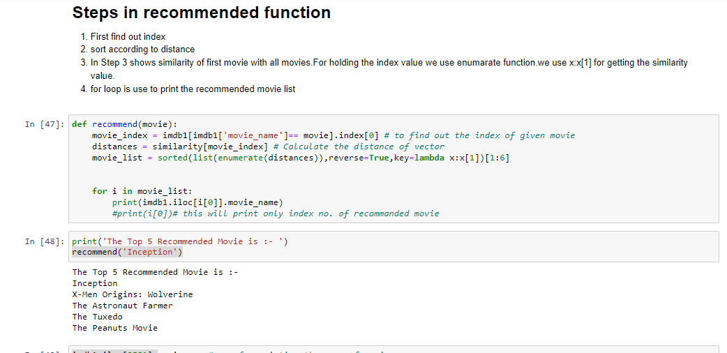
Using Cosine Similarity Convert
Categorical Column in Numerical Column.
Create a Recommended Function for finding out the Top Recommended movie.

Slide 22
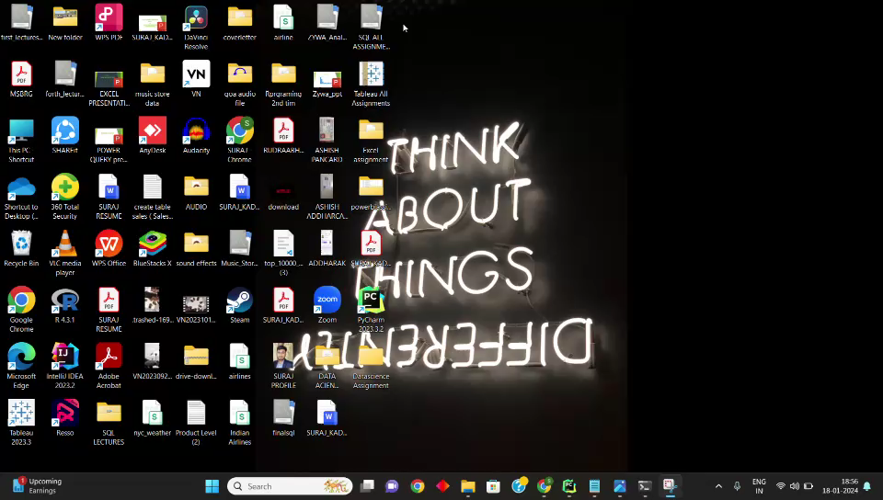
Deployment

Slide 23
Conclusion :-
Throughout the project, sharing ideas and working together to solve challenges and finally we create movie recommendation system which attempts to predict the Preferences of a user, and make a top 5 suggestion based on this preferences.

Slide 24


